Slide 1
Invoice Processing Using RPA
Team Members : 1.K .P. Arthi[711716104010]
2.G.Gokula Krishnan [711716104026]
3.S.Hari Priya[711716104032]
4.H.Iswariya[711716104035]
Faculty Guide : Ms. T. N. Aruna
Assistant Professor
Department of CSE
Industrial Guide :Mr. Pradeep
Department of CSE, KGiSL Institute of Technology, Coimbatore

Slide 2
Abstract In RPA our focus is on pragmatic artificial intelligence (AI) and solve specific customer problems. Using AI to Automate Invoices Processing. Automating manual process aggravation, will enable organization to streamline their accounts payable and expense management process with AI.
Department of CSE, KGiSL Institute of Technology, Coimbatore

Slide 3
Objective & Outcome
Objective:
The Objective of the project is to develop a system that automates the invoice and produce required information for the user.
Outcome:
Company can handle accounts payable process and reduce the time for the financial team.
Department of CSE, KGiSL Institute of Technology, Coimbatore

Slide 4
Area Introduction Robotic Process automation (RPA) is an emerging form of business process automation technology based on the notation of software robots. RPA captures data, runs applications, triggers responses, and communicates with other systems to perform a variety of tasks - Uipath. Existing system Automating the grunt work of retrieving emails, downloading attachments into a defined folder, and create bills in the accounting software.
Department of CSE, KGiSL Institute of Technology, Coimbatore

Slide 5
Drawbacks of existing methods
There are some potential downsides to using invoices, but these are mostly caused by poor management and inadequate process.
High operational costs per invoice on both sender and receiver side
Time Consumption for data extraction
References
Google Suggest Venn Diagram Generator
https://www.searchenginejournal.com/viral-projects-based-on-google-suggest/26457
https://www.uipath.com/blog/uipath-at-work-automating-the-invoice-process
https://www.image-1.com/document-scanning-service-blog/rpa-for-ap-invoice-processing-automation/

Slide 6
Literature
TITLE | PUBLICATION YEAR | PUBLISHER | DESCRIPTION
Business Process: Vendor Payment Process - PO Invoices | 2009 | Massachusetts Institute of Technology | Vendor invoices from purchase orders arrive at the mail desk. The Accounts Payable mail clerk sorts the invoices into categories.
Invoice Processing Procedure (Accounts Payable) | 2012 | University of Alberta | To manage the payment of external supplier invoices for materials, equipment and services purchased on behalf of the University of Alberta.

Slide 7
TITLE | PUBLICATION YEAR | PUBLISHER | DESCRIPTION
Fingate - iProcurement: How to Upload an Invoice | 2016 | Board of Trustees of The Leland Stanford Junior University | Suppliers should mail invoices directly to Accounts Payable (suppliers should see Supplier Instructions for Submitting Invoices).
Invoice Imaging and Data Capture for Accounts Payable | 2008 | PayStream Advisors | OCR and Data Capture are central components to a modern AP automation initiative.

Slide 8
Architectural Design
Unread Message
START
Submit Email Login
Download and save attachments
Extract the details
Notification to client
Output Generation
Department of CSE, KGiSL Institute of Technology, Coimbatore

Slide 9
Level 0:
Product
Management
Payment
Management
Client
Management
Invoice Management
system
System User
Management
Supplier
Management
Login
Management

Slide 10
Level 1:
Generate
Client
Report
Client
Management
Generate product
Report
Product
Management
Invoice Management
system
Generate Payment
Report
Payment
Management
Generate Supplier
Report
Supplier
Management
Login
Management
Check user Login Details
Generate System User
Report
System User
Management

Slide 11
Proposed System
This new AI activity will enable UiPath Robots to read invoices and help automate customers accounts payable and expense compliance processes
It is no longer necessary to create multiple layouts manually
This Invoice AI is also trained to understand real world documents even if document includes ‘noise’
Advantages Over Existing System
Templateless approach to process invoices
Address complexities found in real world documents
Department of CSE, KGiSL Institute of Technology, Coimbatore

Slide 12
Module Split up Module 1: Retrieving emails, downloading attachments into a defined folder Module 2: Reading invoices using AI and Extracting Key Information Module 3: Opening and Filling invoices details in Excel and sending email Notifications, as well as other background activities
Department of CSE, KGiSL Institute of Technology, Coimbatore

Slide 13
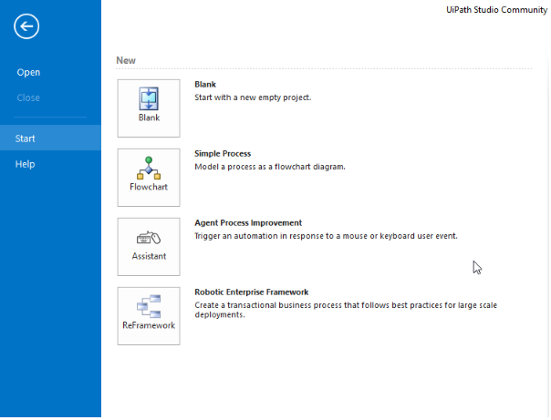
Screen shots of modules under progress.
Uipath studio
Department of CSE, KGiSL Institute of Technology, Coimbatore

Slide 14
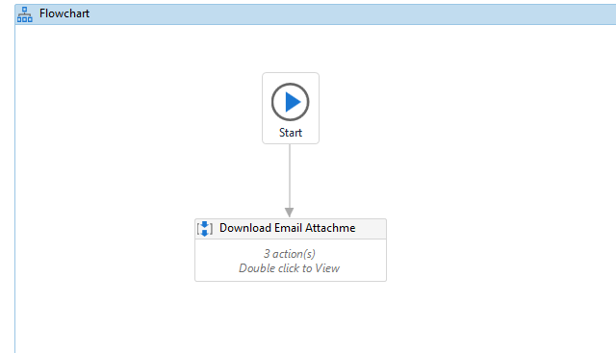
Flowchart start for Downloading E-mails
Department of CSE, KGiSL Institute of Technology, Coimbatore

Slide 15
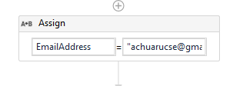
Variable assigning

Slide 16
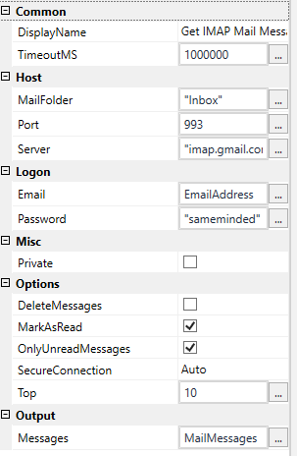
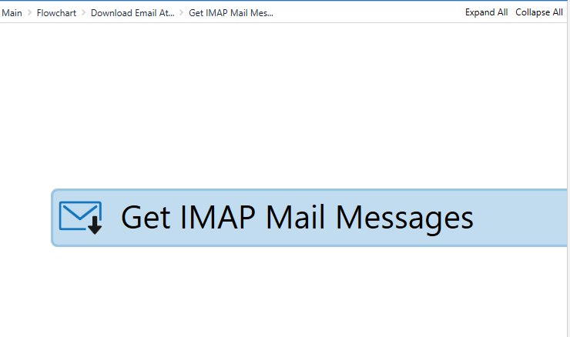
Opening mail

Slide 17
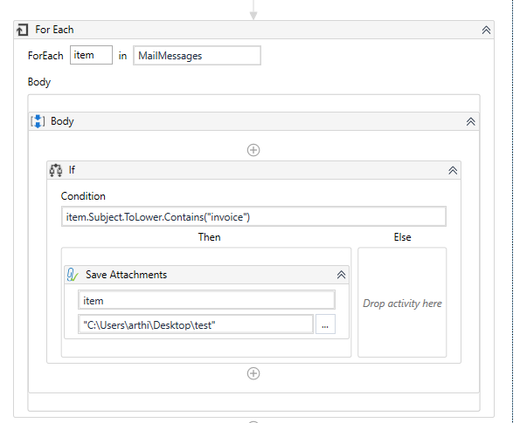
Save in a defined folder

Slide 18
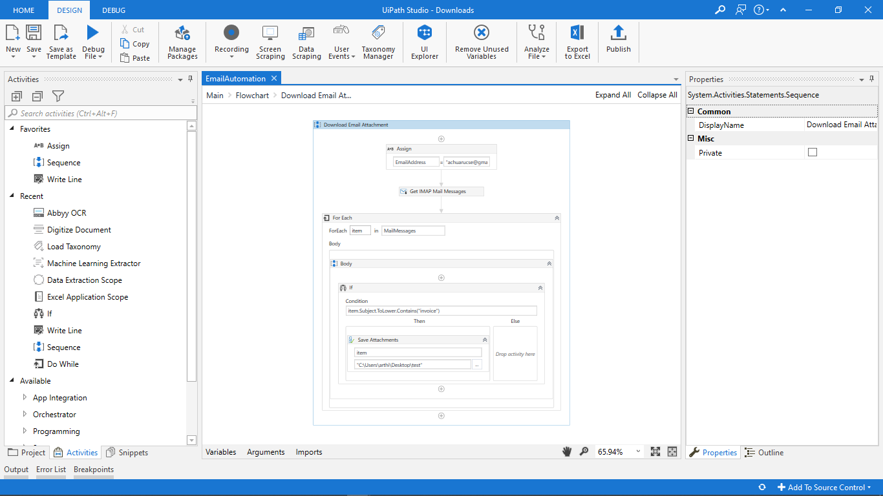

Slide 19
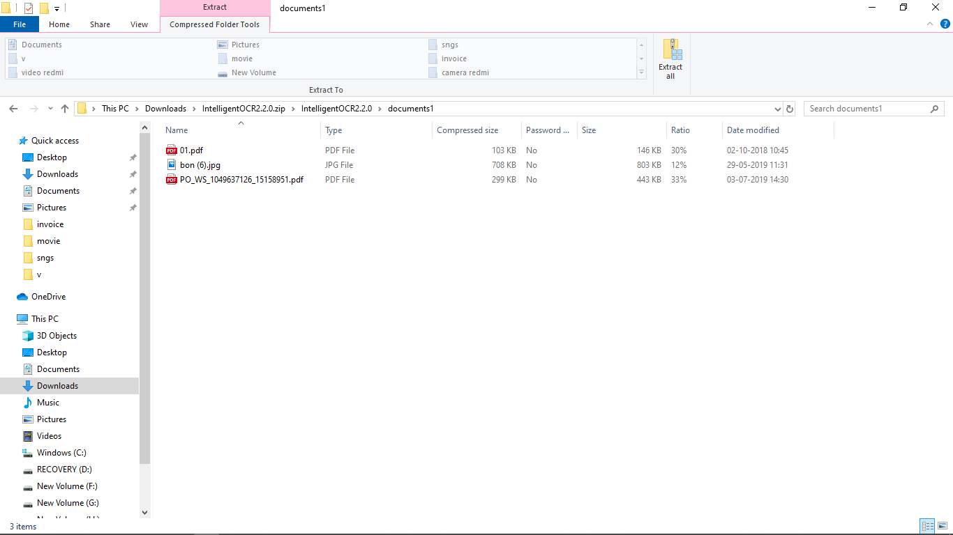
Folder:

Slide 20
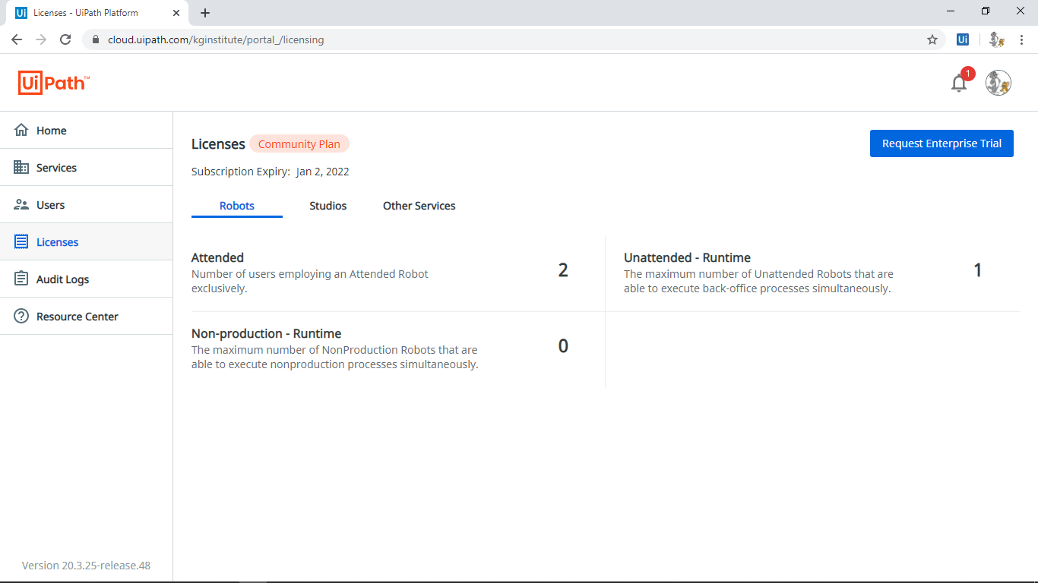
Generation of API Key:

Slide 21
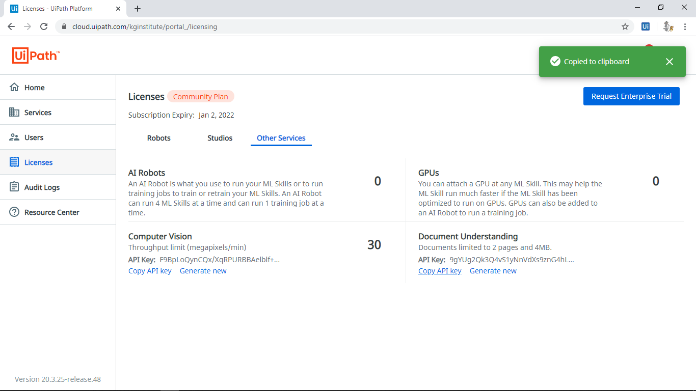

Slide 22
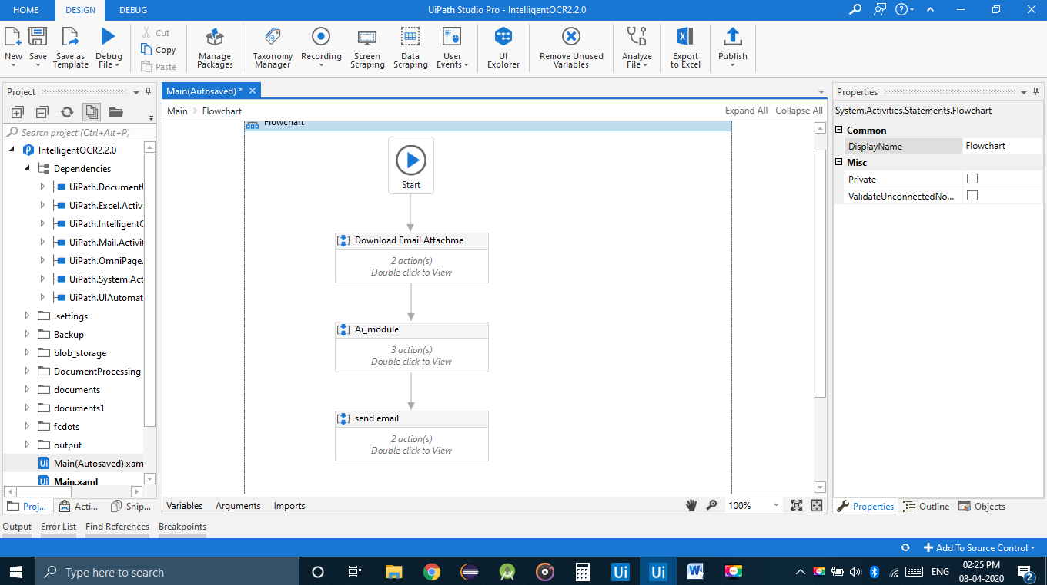
AI Extraction:

Slide 23
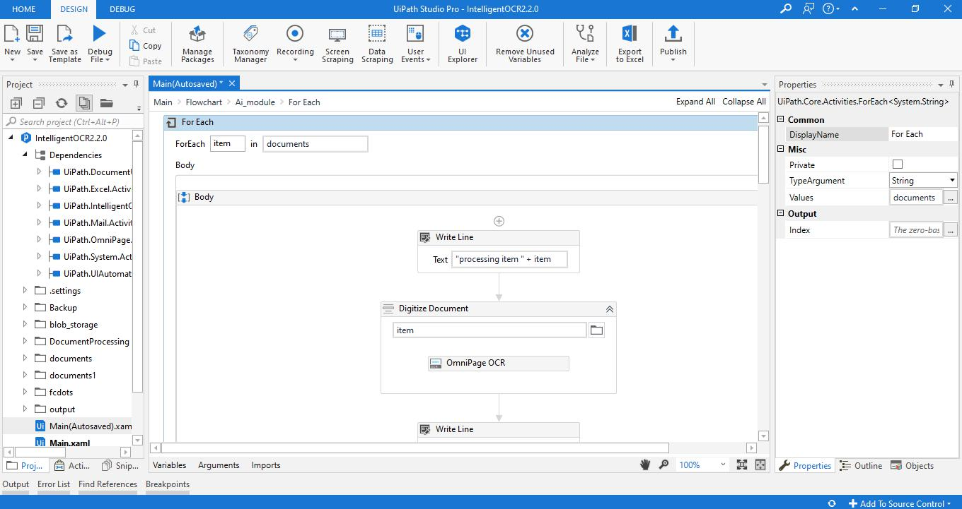

Slide 24
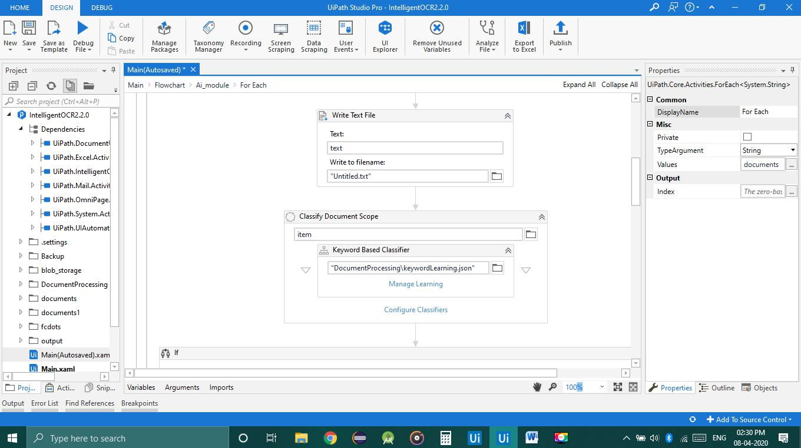

Slide 25
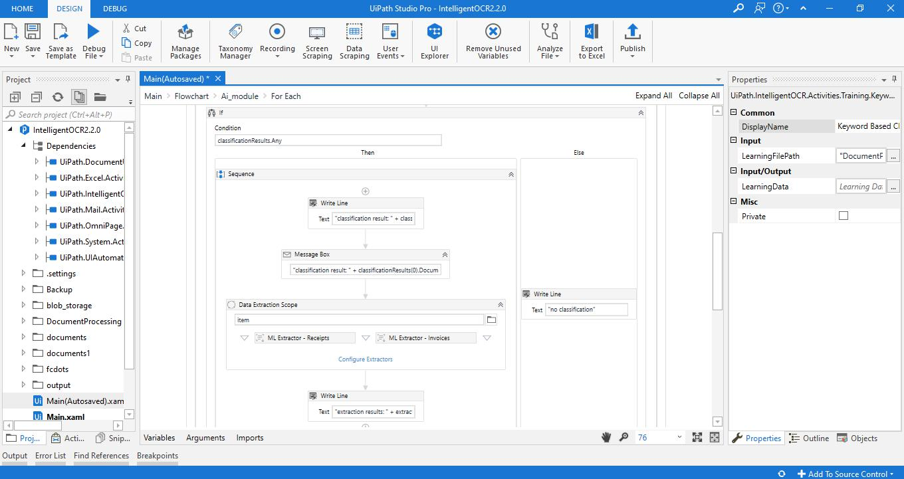

Slide 26
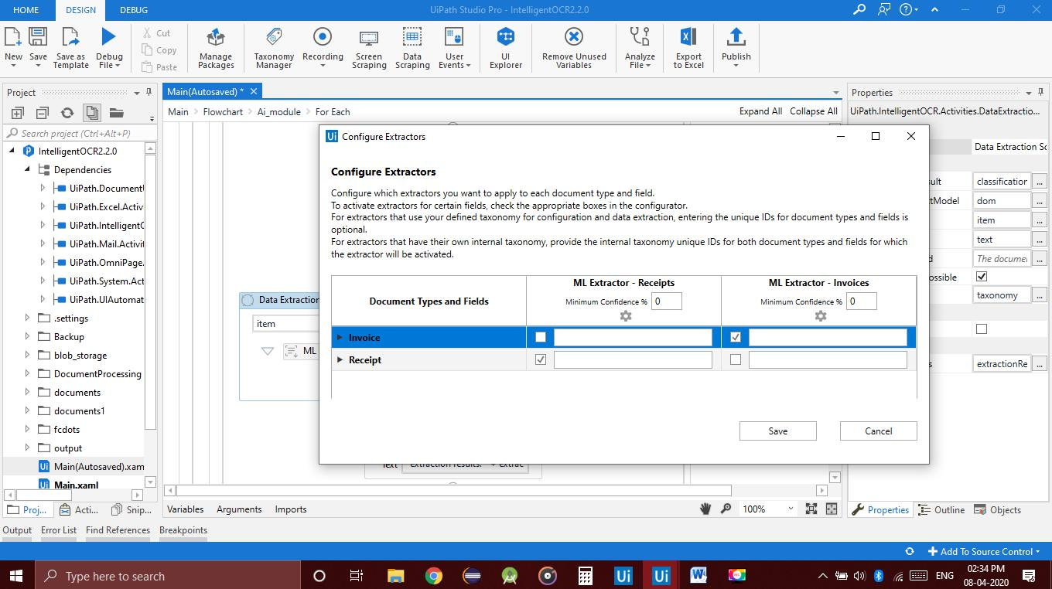

Slide 27
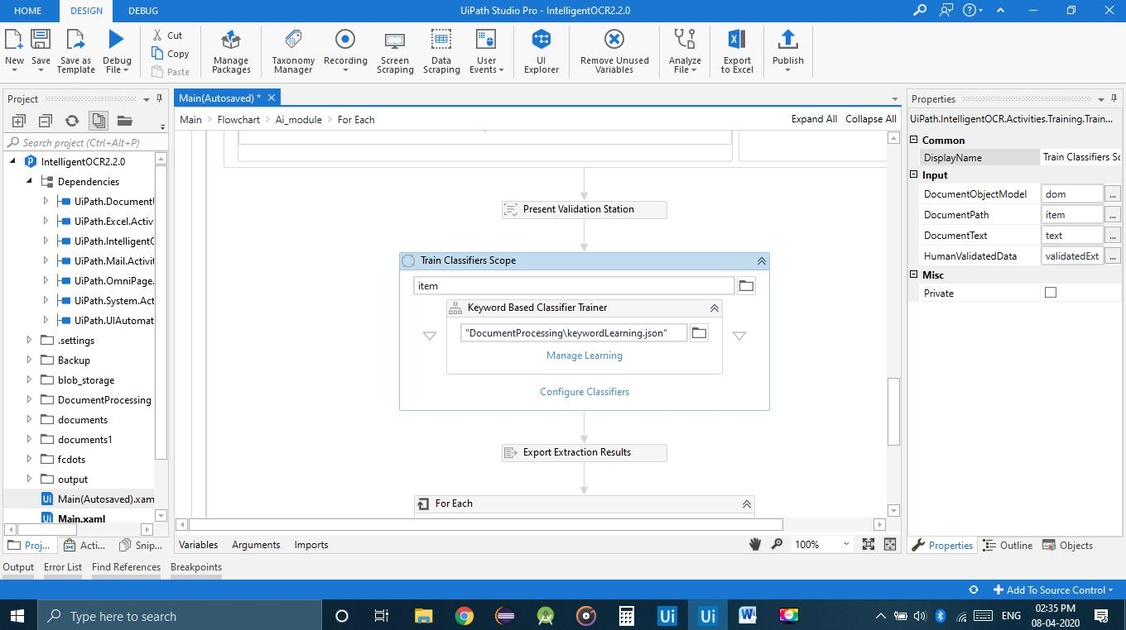

Slide 28
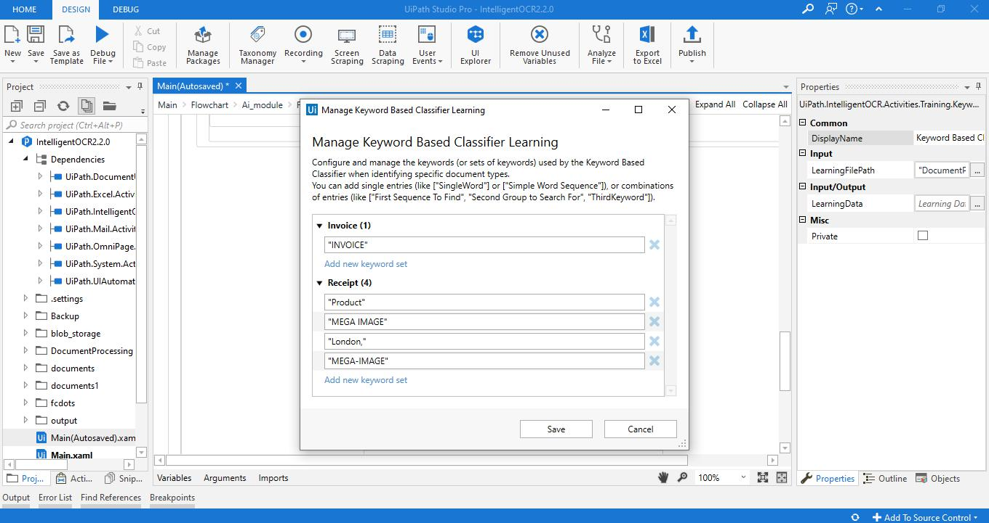

Slide 29
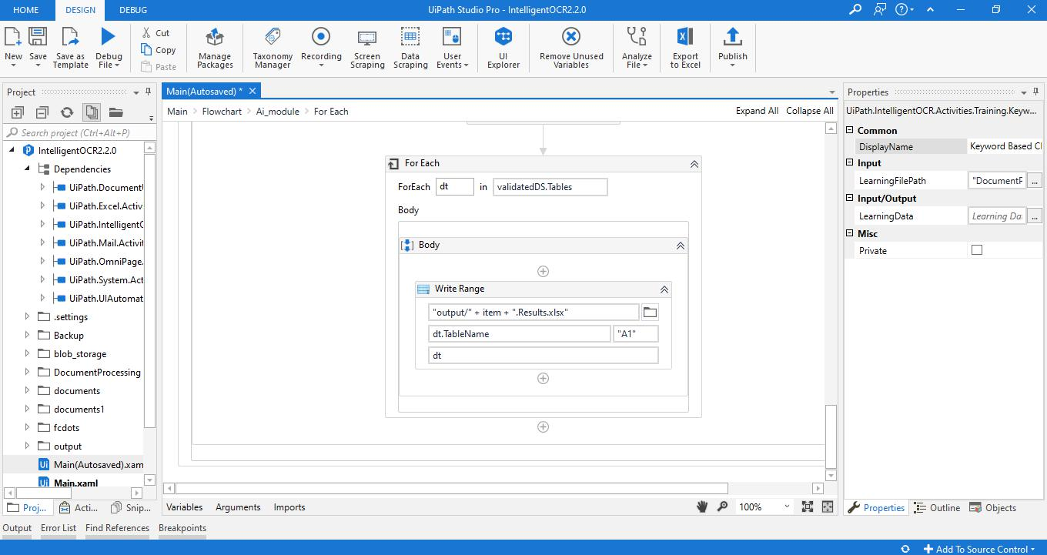

Slide 30
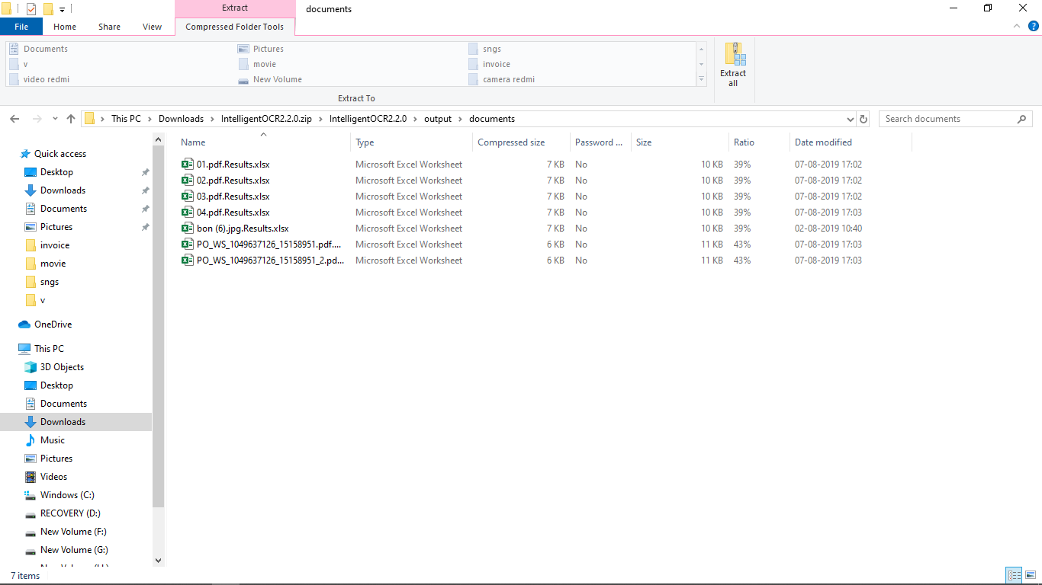
Output:

Slide 31
Notification:

Slide 32
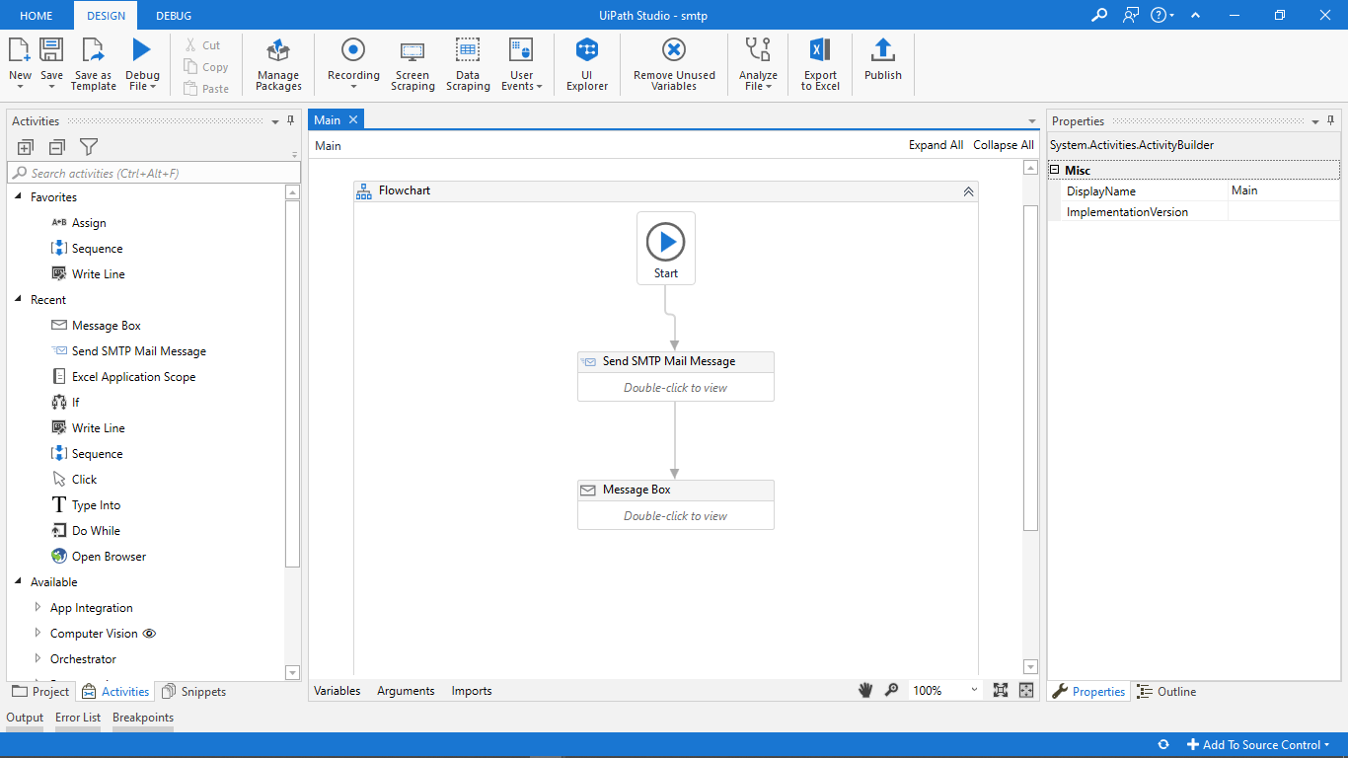

Slide 33
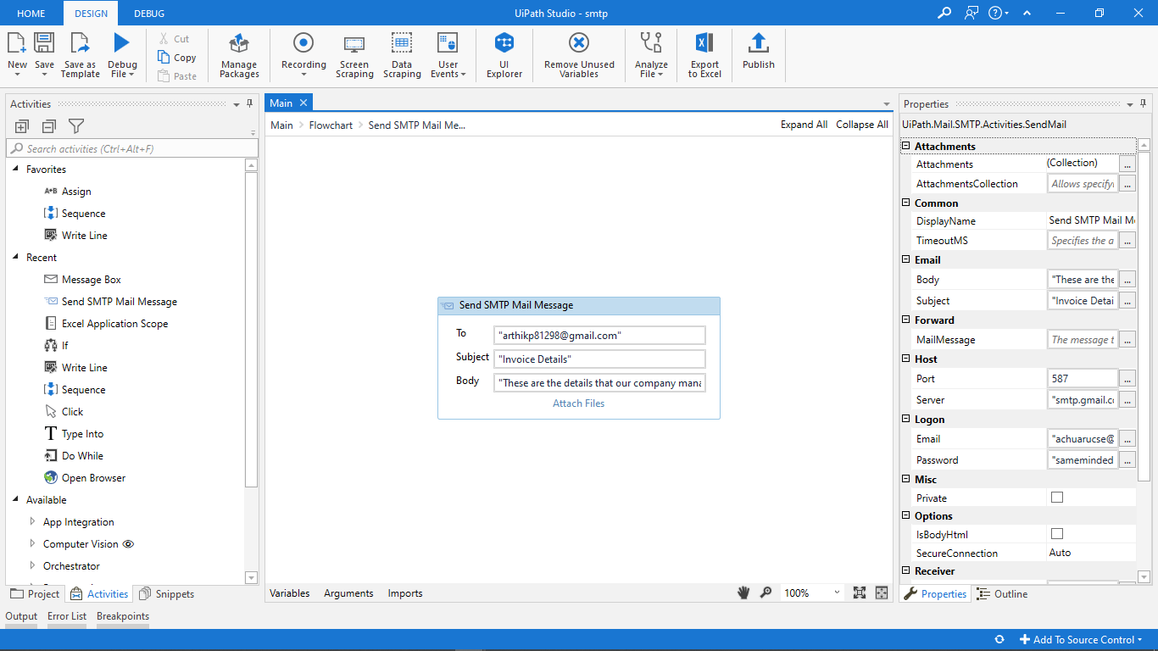

Slide 34
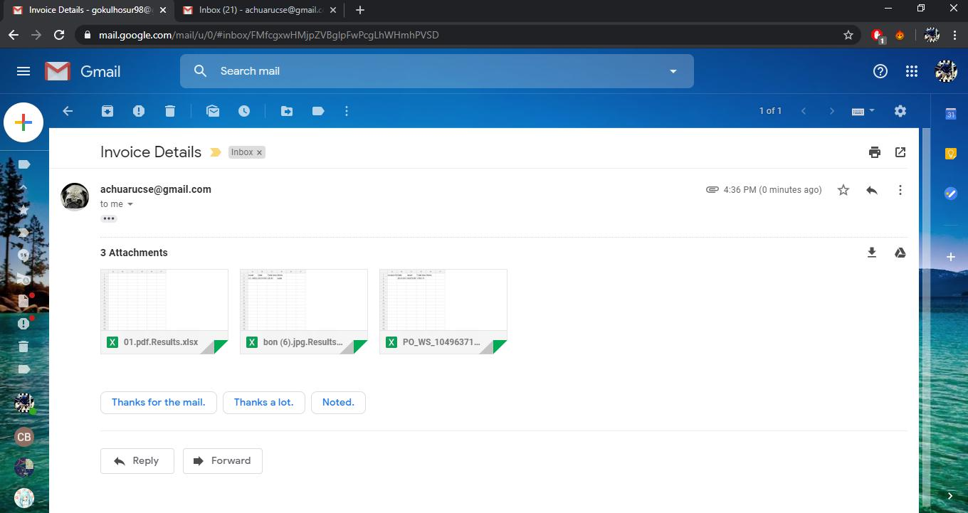
Output:

Slide 35
Project Planner / Timeline chart)
Particulars | Dec |  |  |  | Jan |  |  |  | FEb |  |  |  | Mar
 | Wk 1 | Wk 2 | Wk 3 | Wk 4 | Wk 1 | Wk 2 | Wk 3 | Wk 4 | Wk 1 | Wk 2 | Wk 3 | Wk 4 | Wk 1 | Wk 2 | Wk 3 | Wk 4
Problem Identification
Literature Survey
Module 1
Module 2
Module 3
Module 4
Thesis Draft
Final Thesis
Viva
Department of CSE, KGiSL Institute of Technology, Coimbatore

